Slide 1
Windows Container Glyphs
Created by Martin McClean.
Direct any questions, suggestions or alterations to mmcclean@microsoft.com

Slide 2
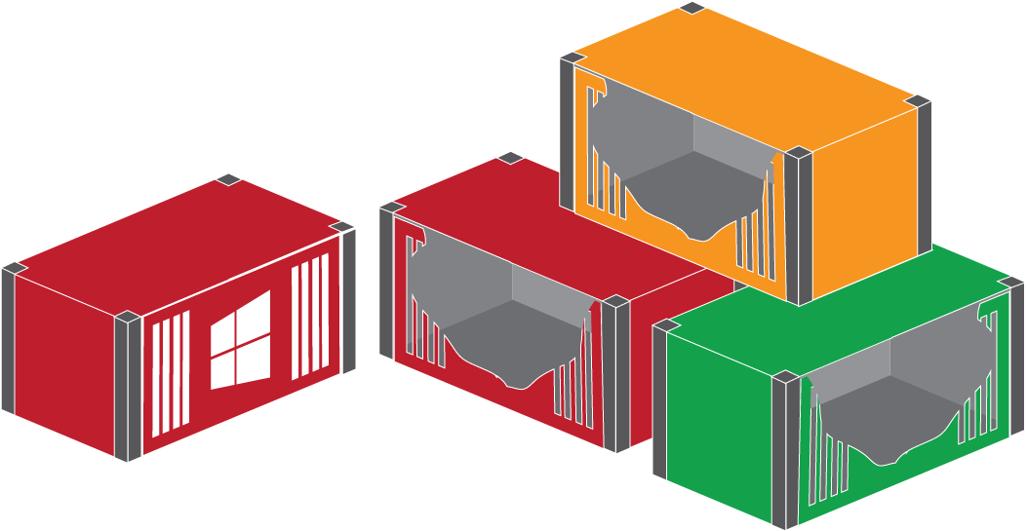
Using Windows Container Glyphs
You can use the following glyphs (or symbols) to build your Windows Container drawings for presentations and for your documentation.
For example, you can combine some of the glyphs to form the following on the right.
Direct any questions, suggestions or alterations to mmcclean@microsoft.com

Slide 3
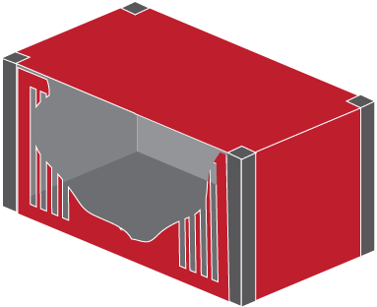
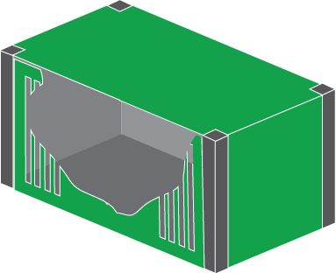
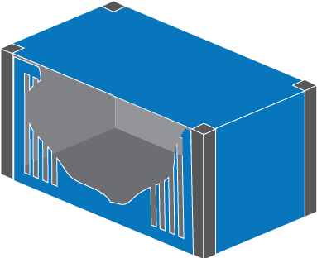
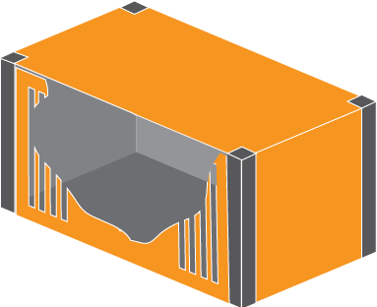
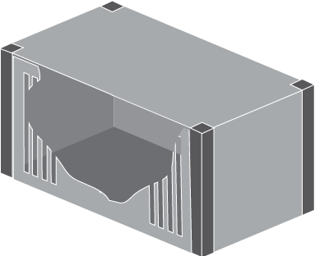

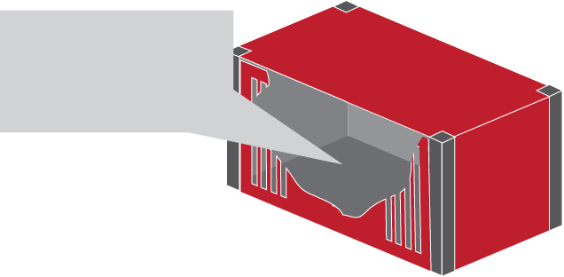
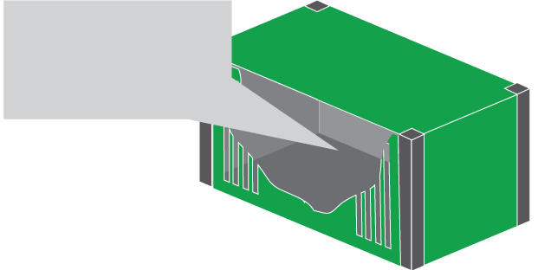
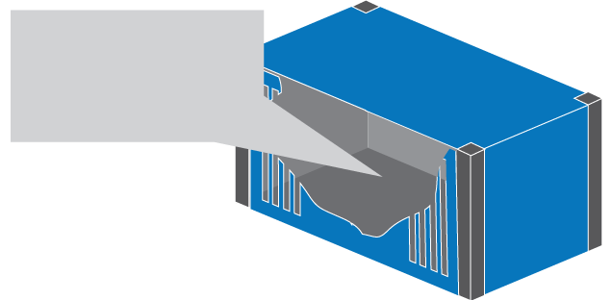

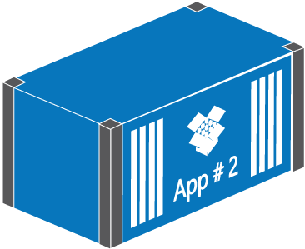
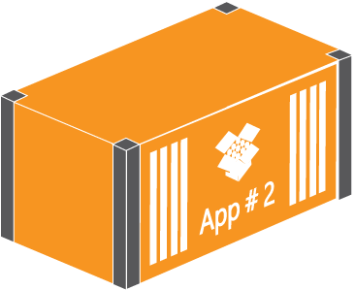
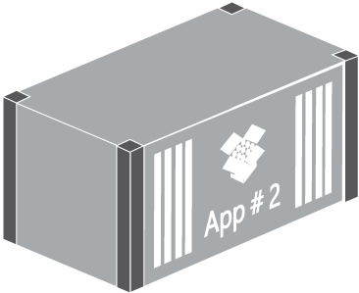
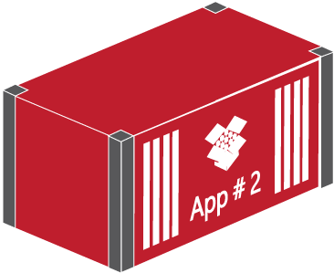
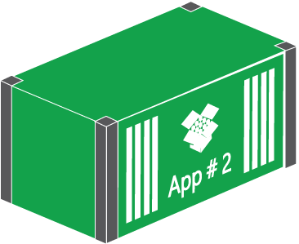
3D Windows Container Glyphs
3D Cut-away Containers
3D Cut-away callout Containers
Insert Text
Insert Text
Insert Text
Insert Text
3D App #2 Generic Containers

Slide 4
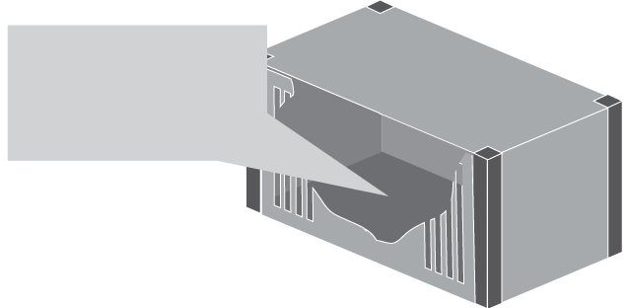
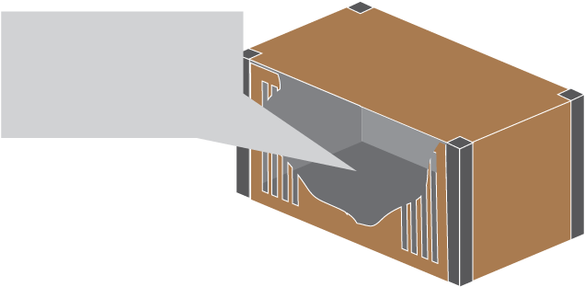
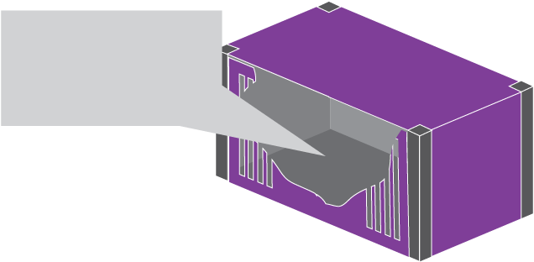

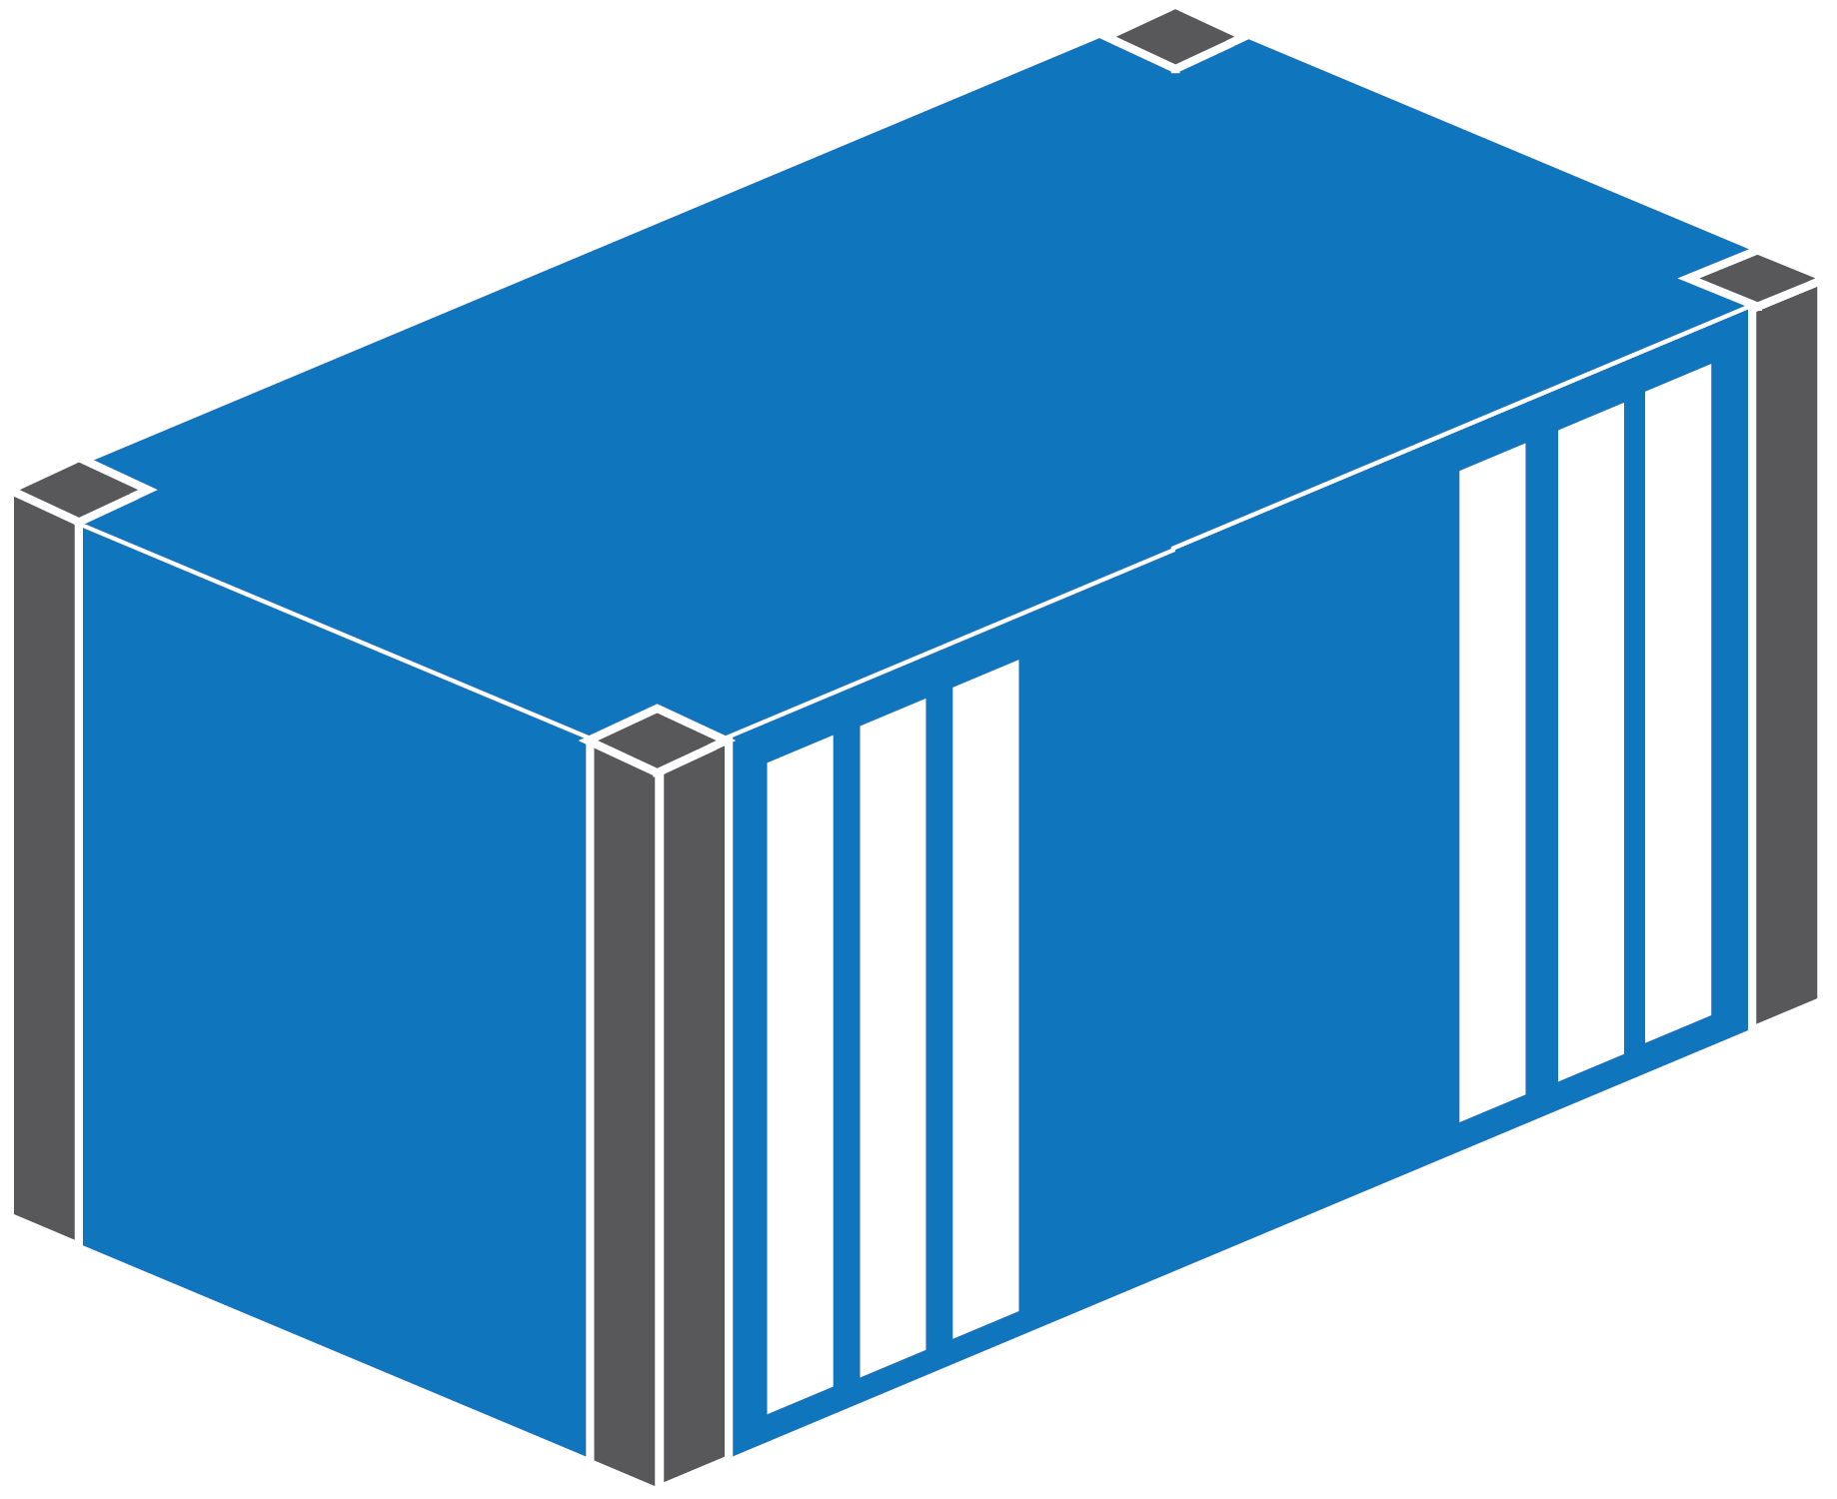
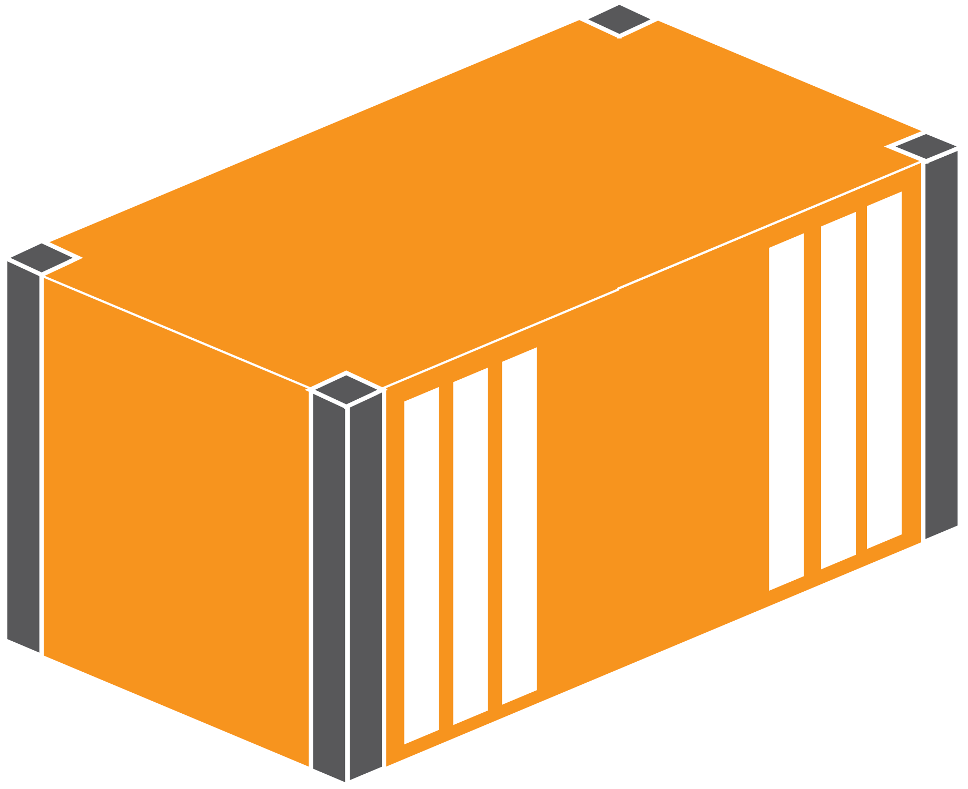
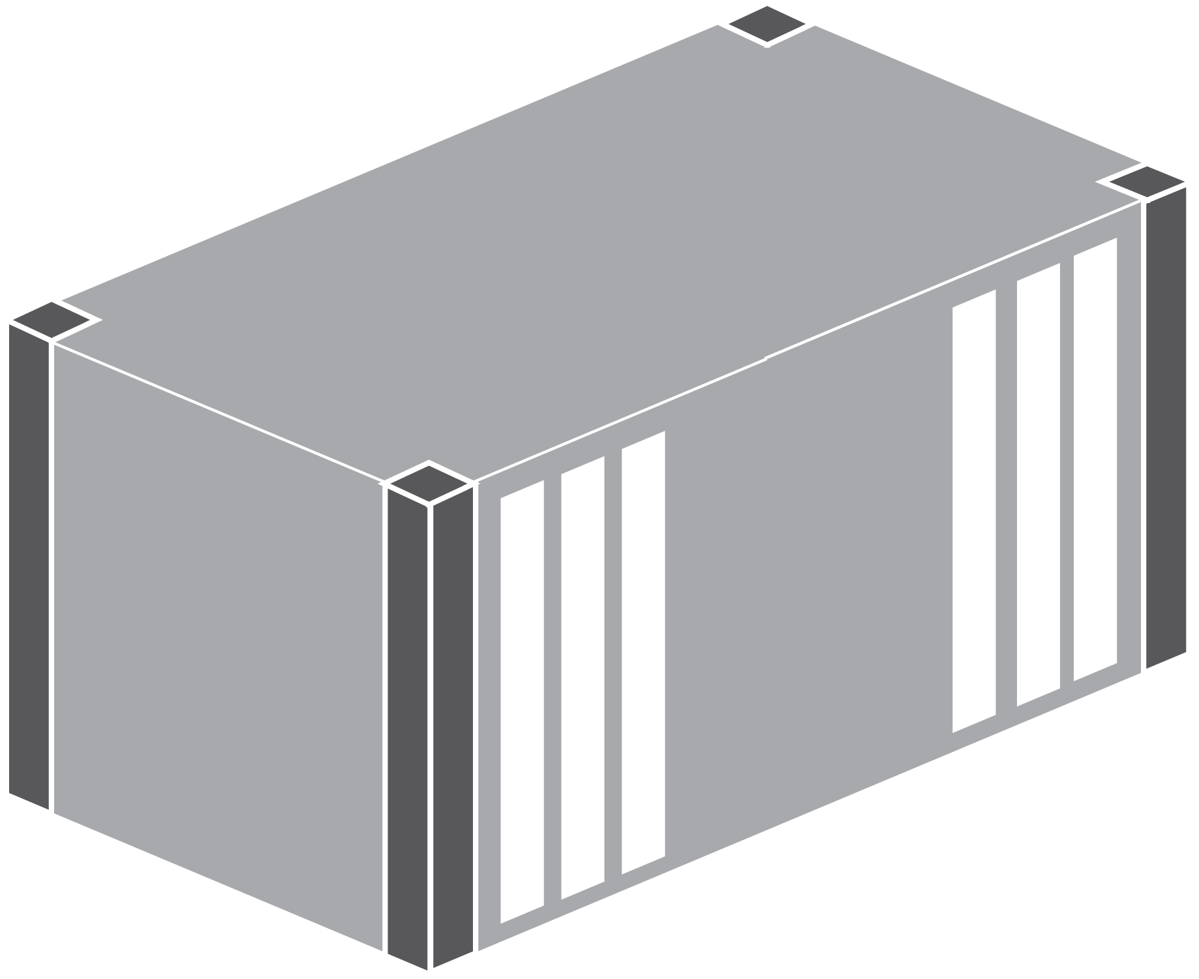
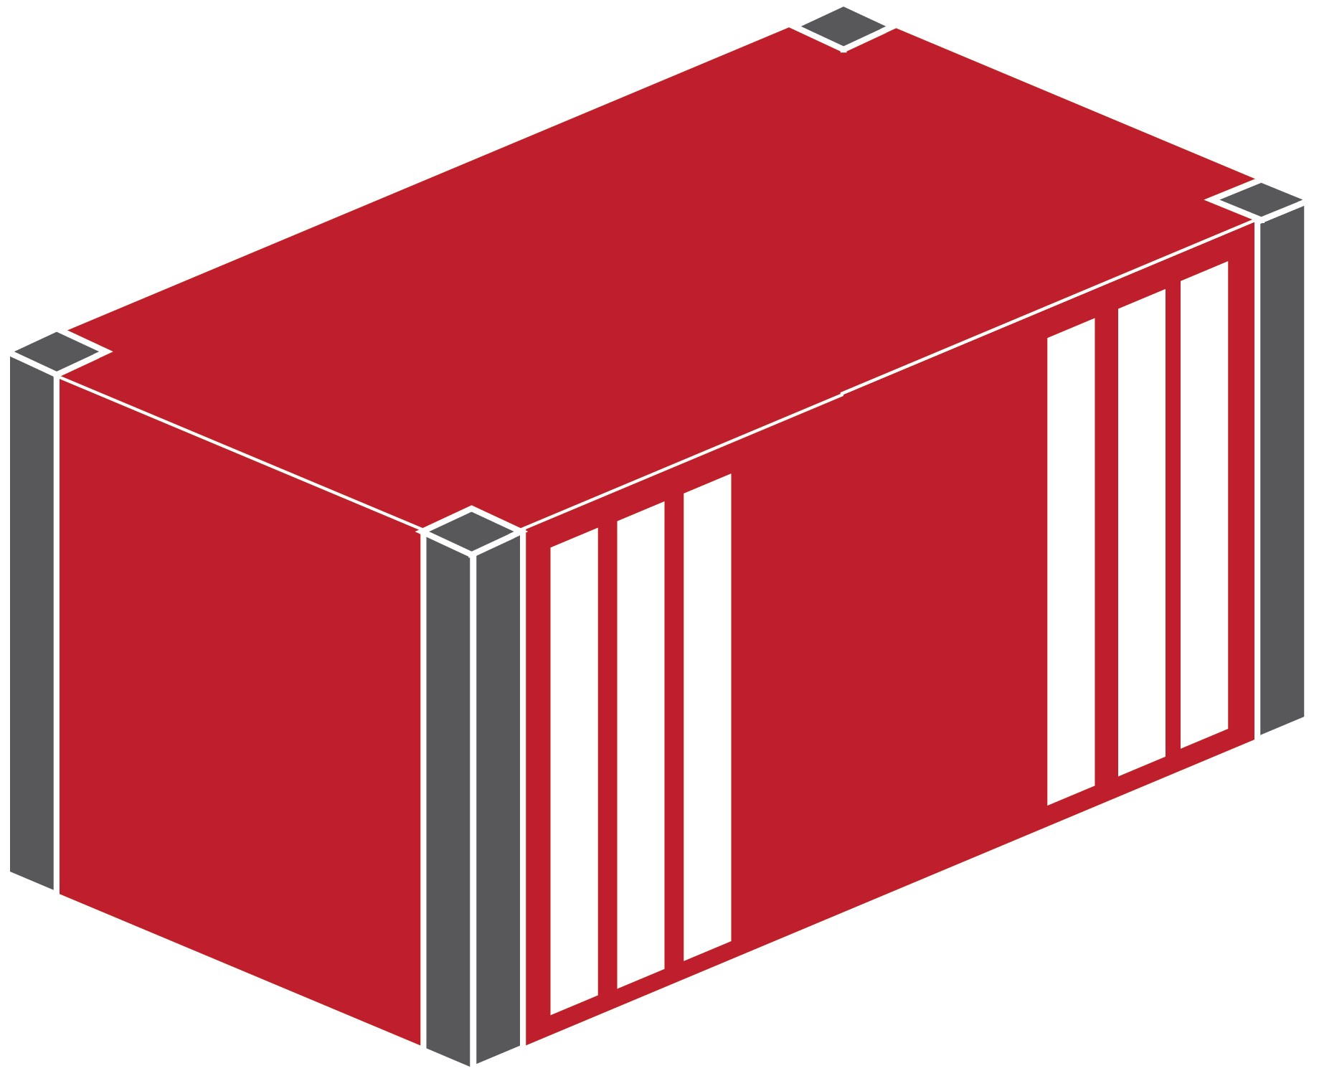
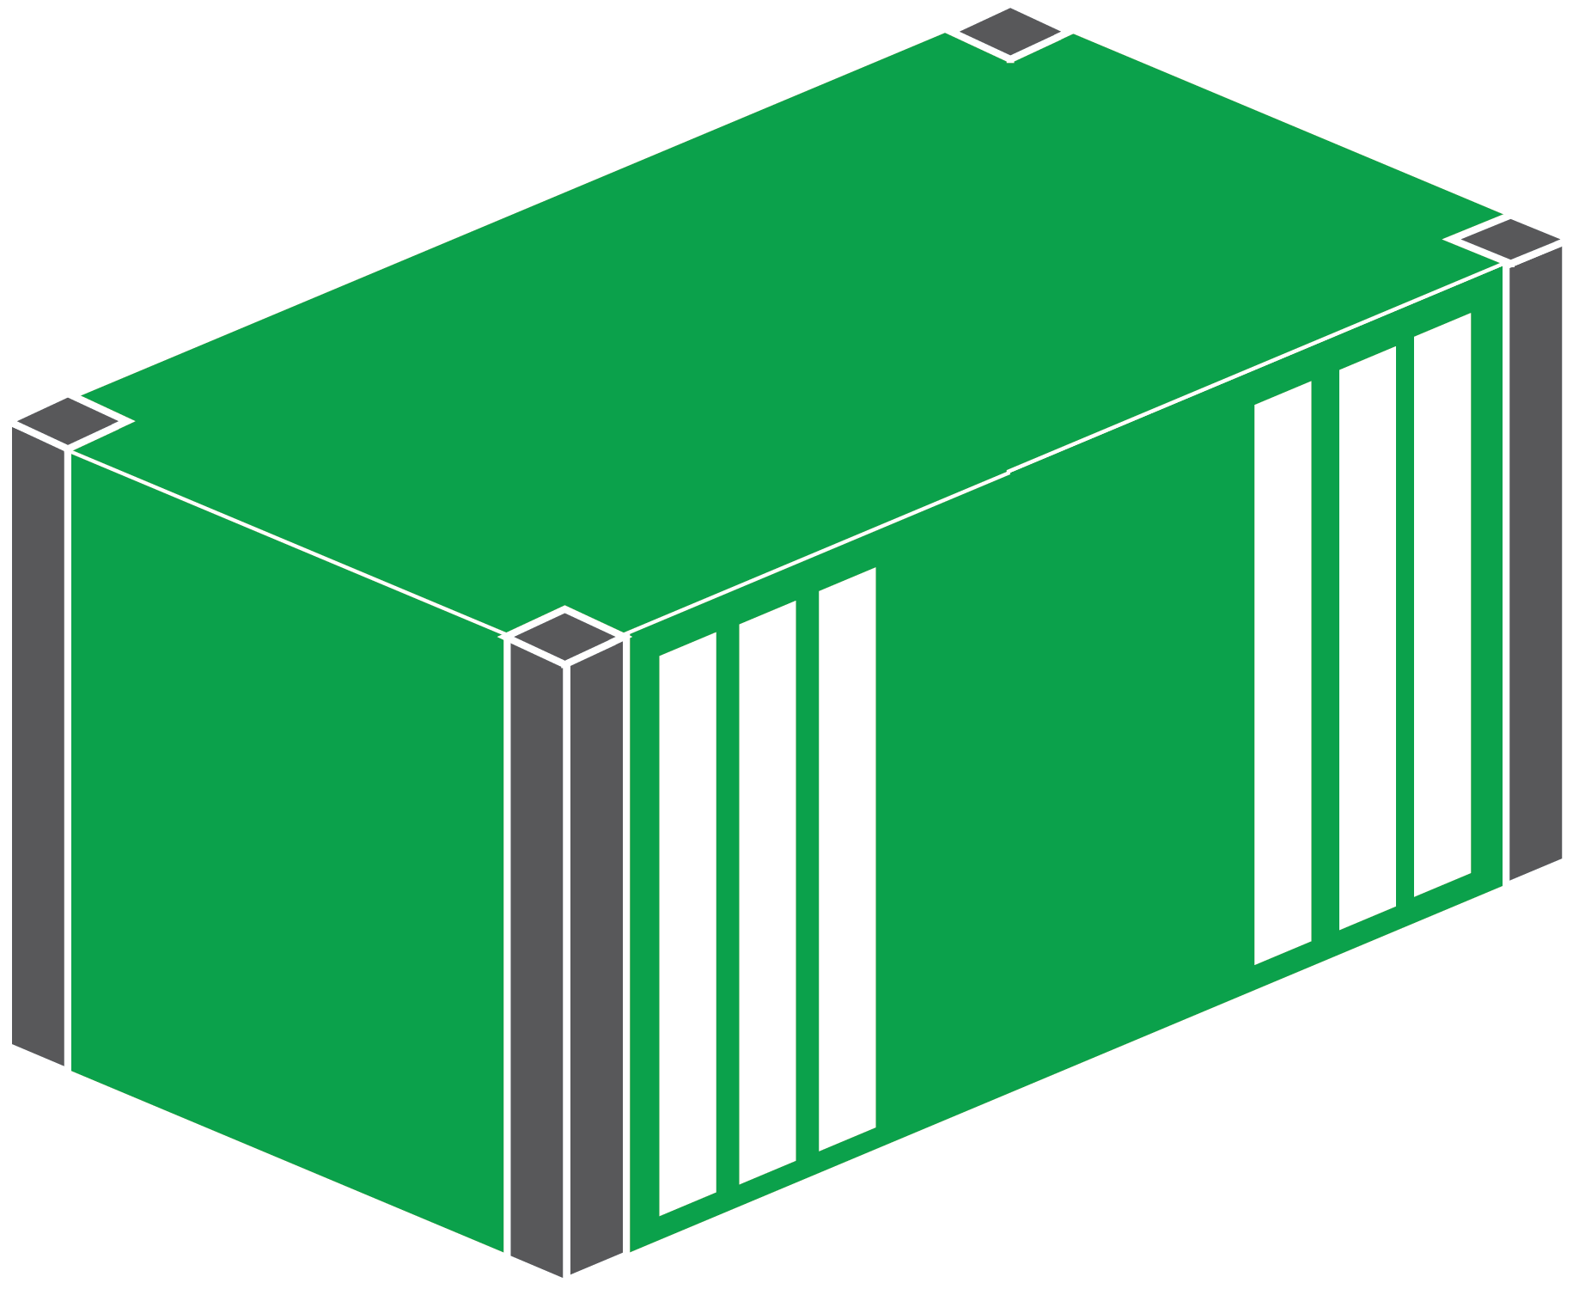
3D Windows Container Glyphs
3D Callout Containers
Insert Text
Insert Text
Insert Text
Insert Text
3D App #2 Generic Containers
3D Solid Containers

Slide 5
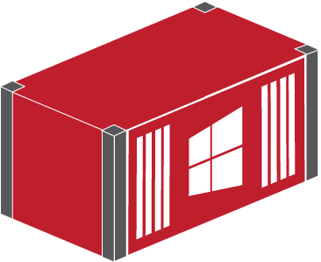
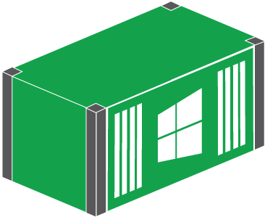
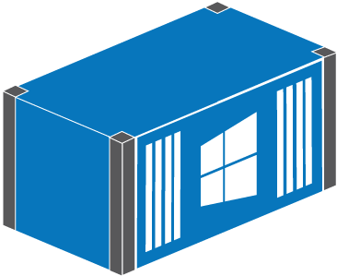
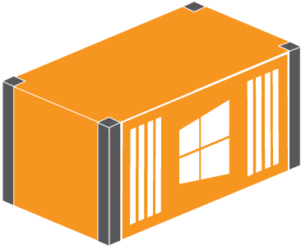
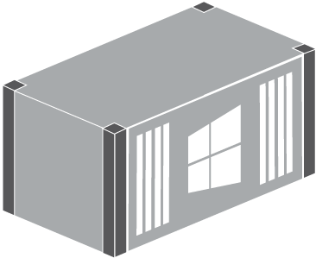
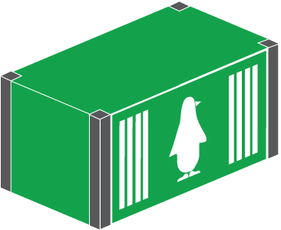
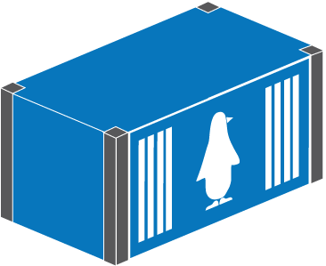

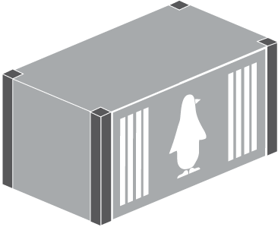

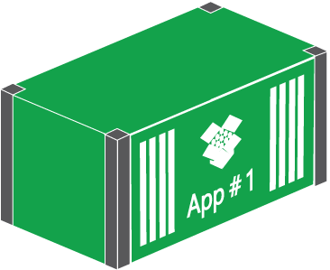
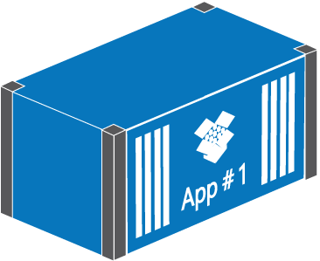
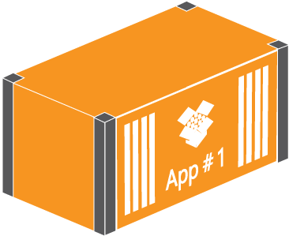
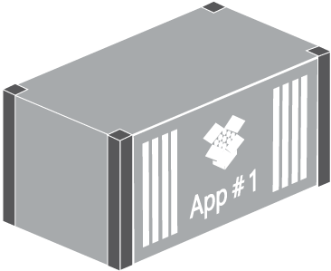
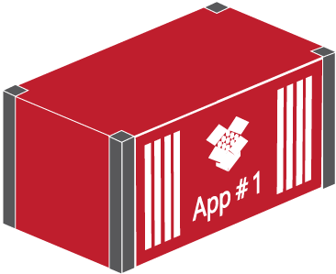
3D Windows Container Glyphs
3D Windows Containers
3D Linux Containers
3D App #1 Generic Containers

Slide 6

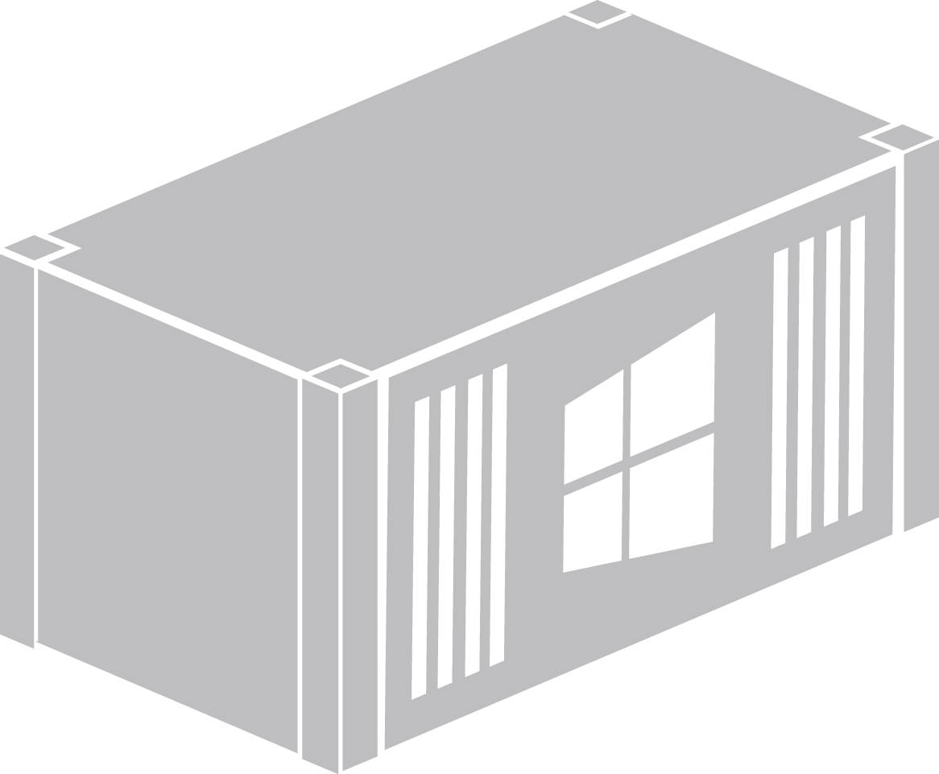


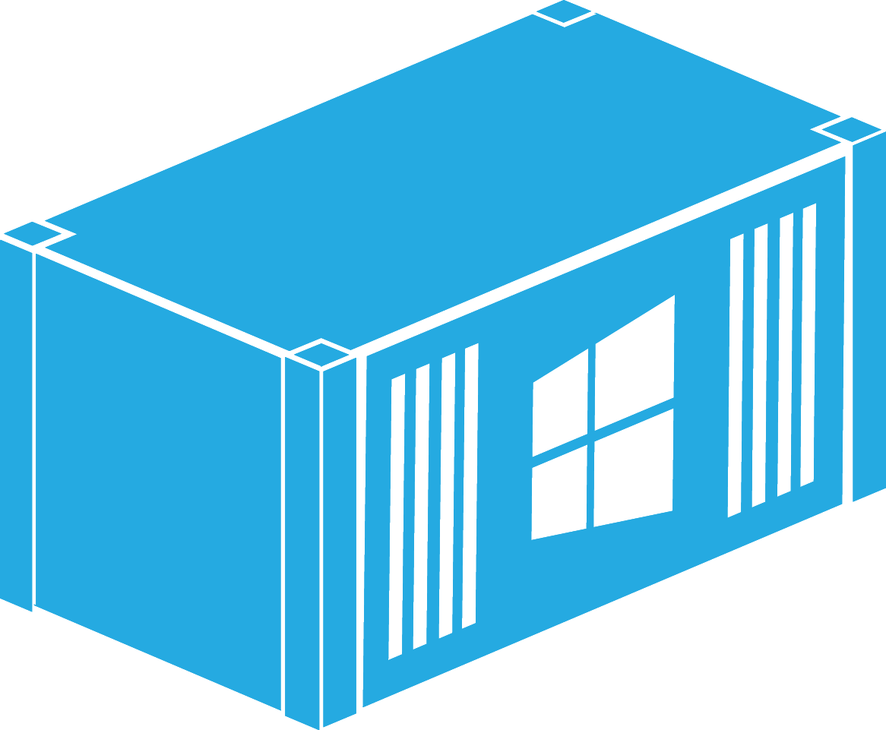
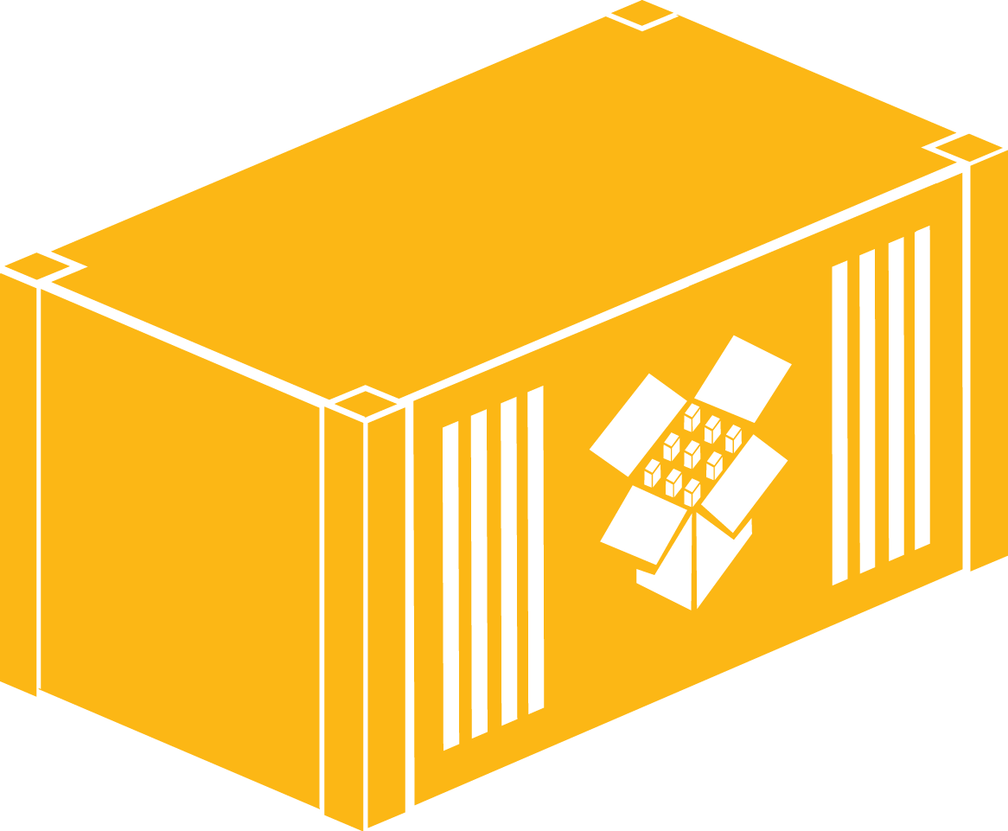
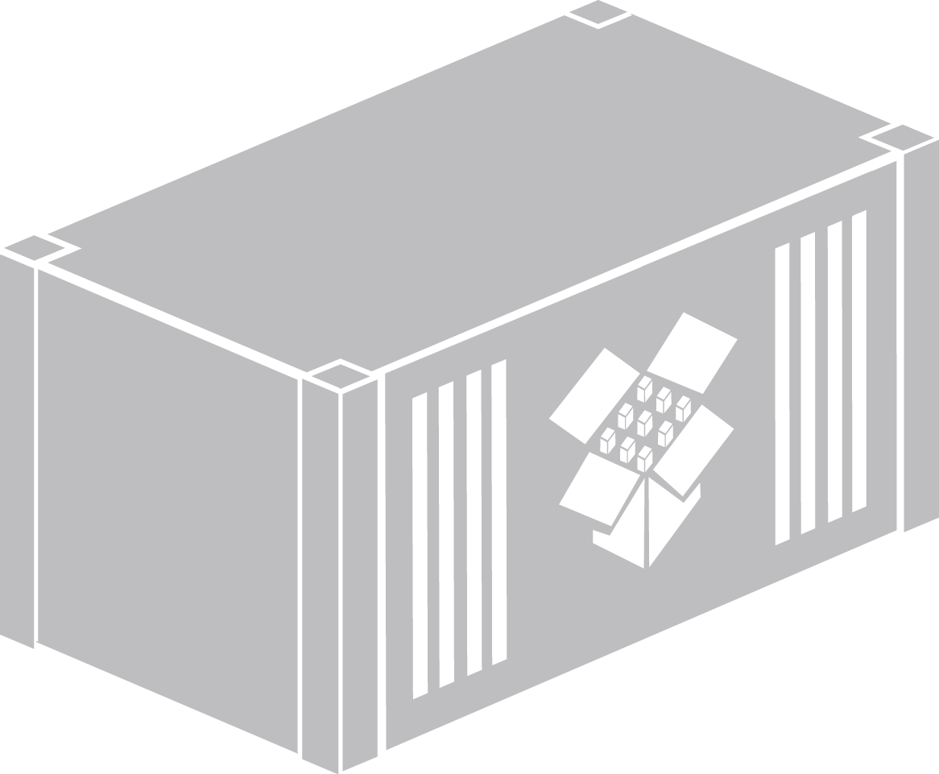
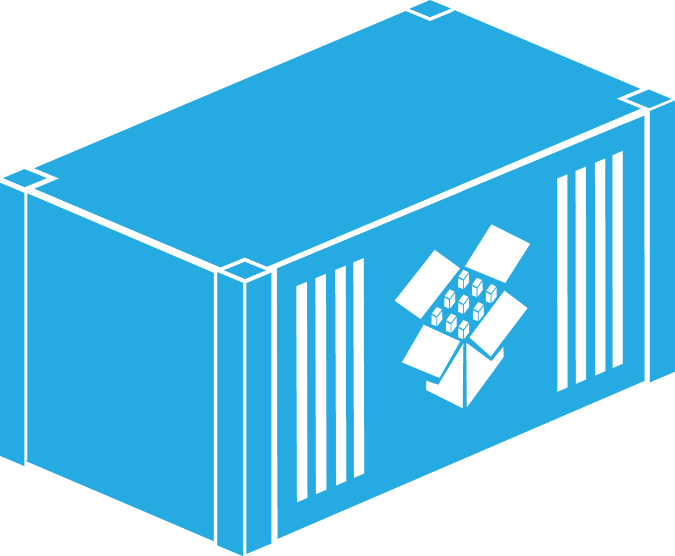

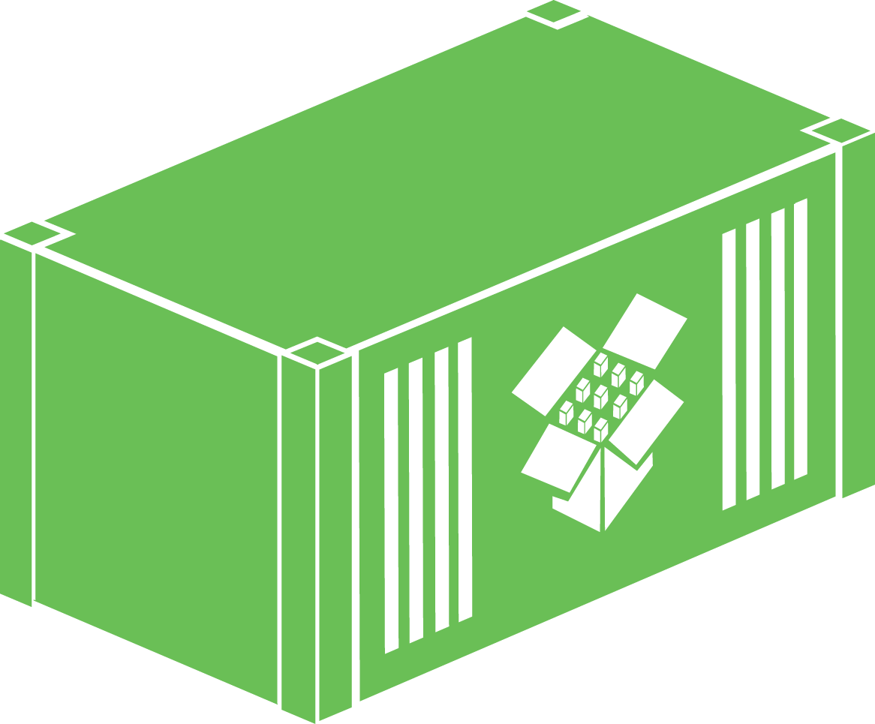
3D Windows Container Glyphs
3D Windows Containers
3D App Generic Containers

Slide 7
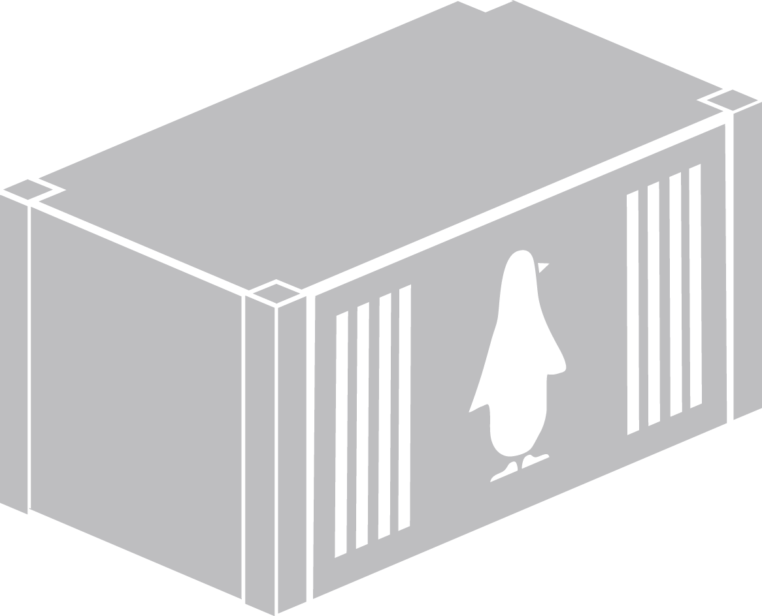





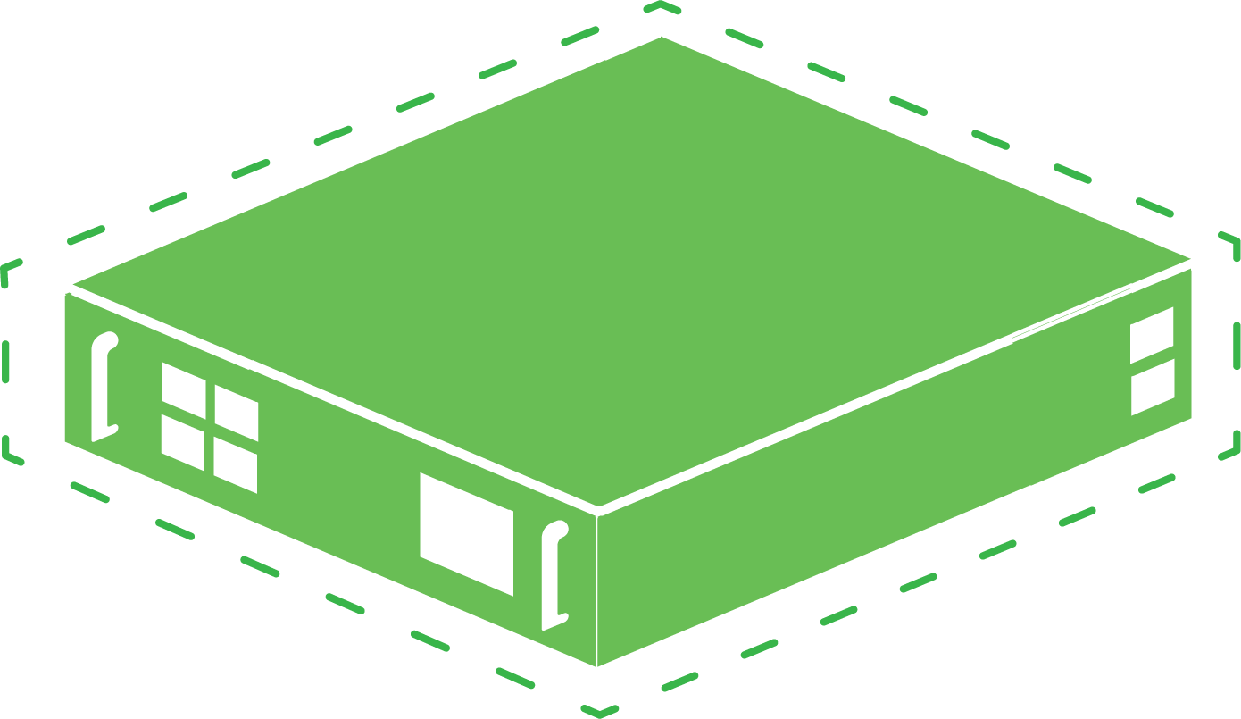
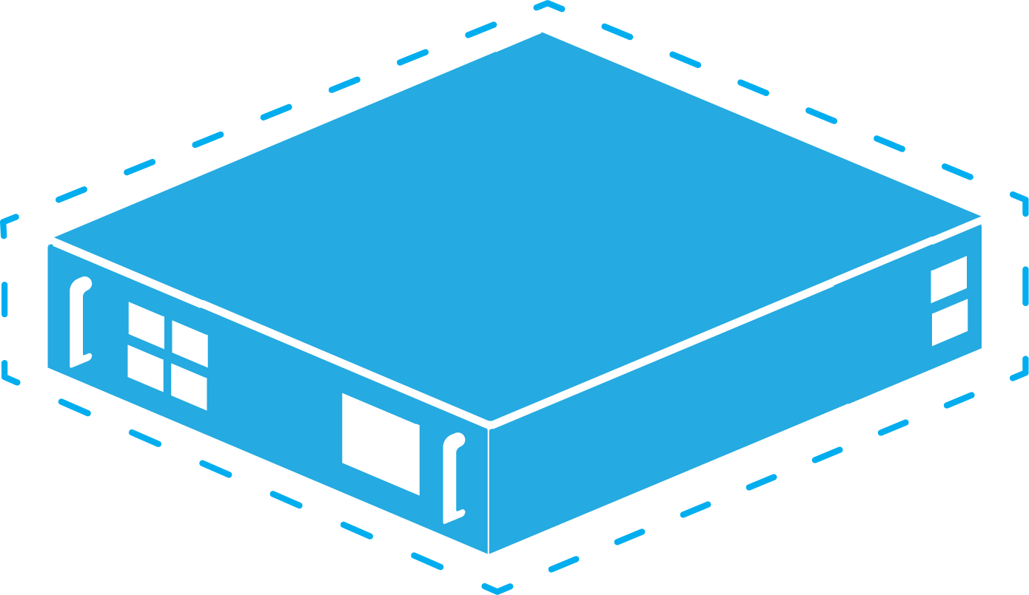
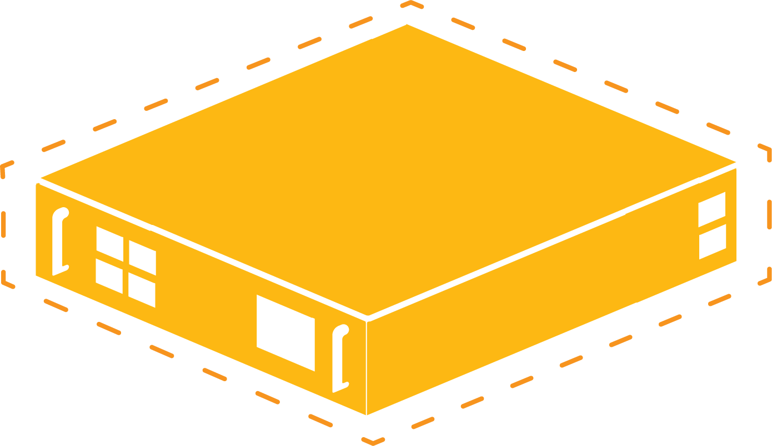
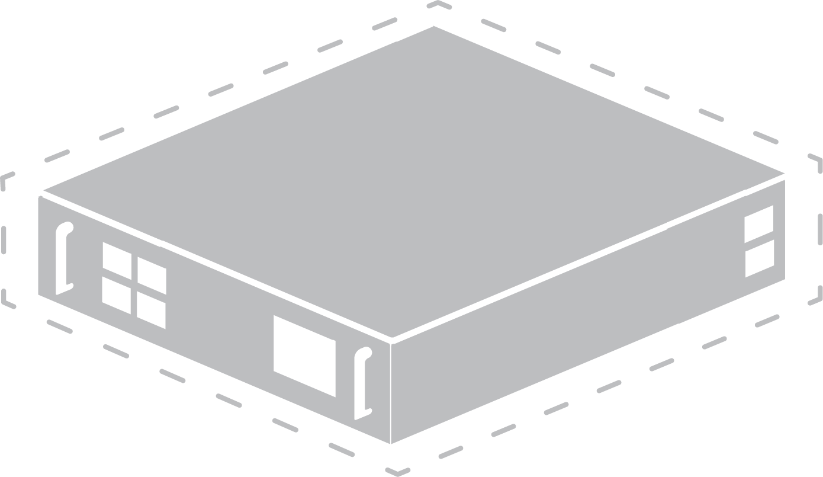
3D Windows Container Glyphs
3D Windows Containers
3D Linux Containers
3D Virtual Machine

Slide 8
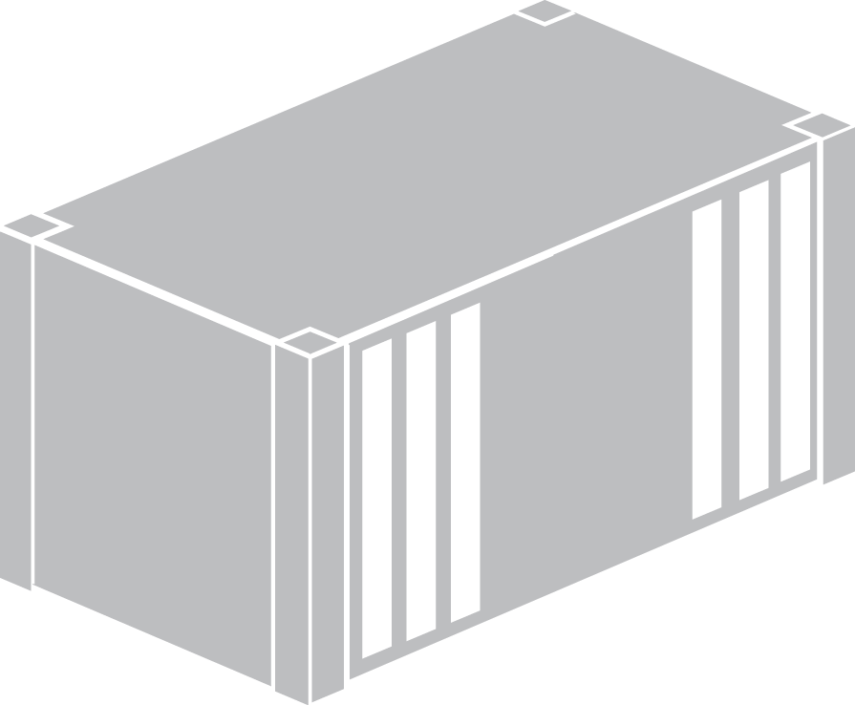
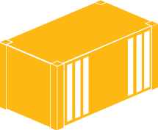
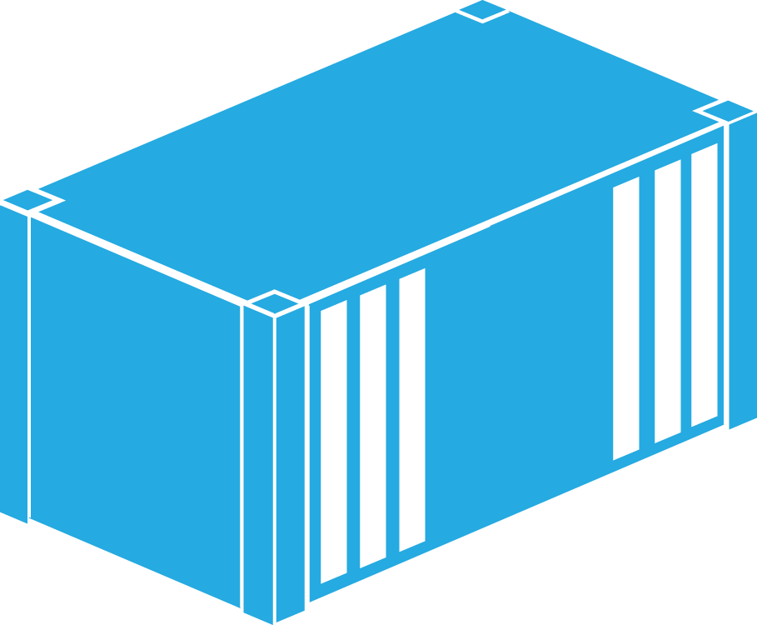

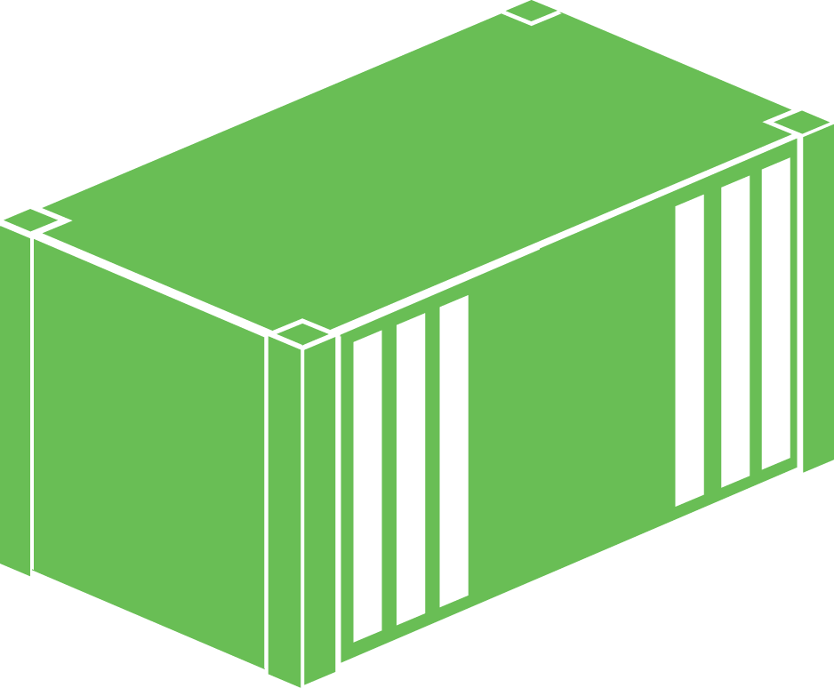





Windows Container Glyphs
3D Container
3D Windows Server

Slide 9










3D Windows Container Glyphs
3D App #2 In Container
3D App #1 In Container

Slide 10














Windows Container Glyphs
App In Container
Windows Container
Linux Container

Slide 11












Windows Container Glyphs
Container Images Repo
Container Image
Scratch Image

Slide 12










Windows Container Glyphs
Docker Engine
Windows Server 2012 R2

Slide 13















Windows Server Container Glyphs
Sample Apps Containers (#1)
Sample Apps Containers (#2)
Azure Container

Slide 14




















Windows Container Glyphs
Virtual Machine (Choice #1)
Virtual Machine (Choice #2)
Virtual Machine (Choice #3)
Virtual Machine (with application installed)

Slide 15




















Windows Server Container Glyphs
Virtual Machine (with Container)
Physical Computer with Containers
Clouds
Applications

Slide 16














Windows Server Container Glyphs
Containers Storage
Linked Container (Choice #1)
Linked Container (Choice #2)

Slide 17



















Windows Container Glyphs
Physical Computer/Server
Physical Computer (with installed application)
Users / Developers
Container Management

